Slide 1
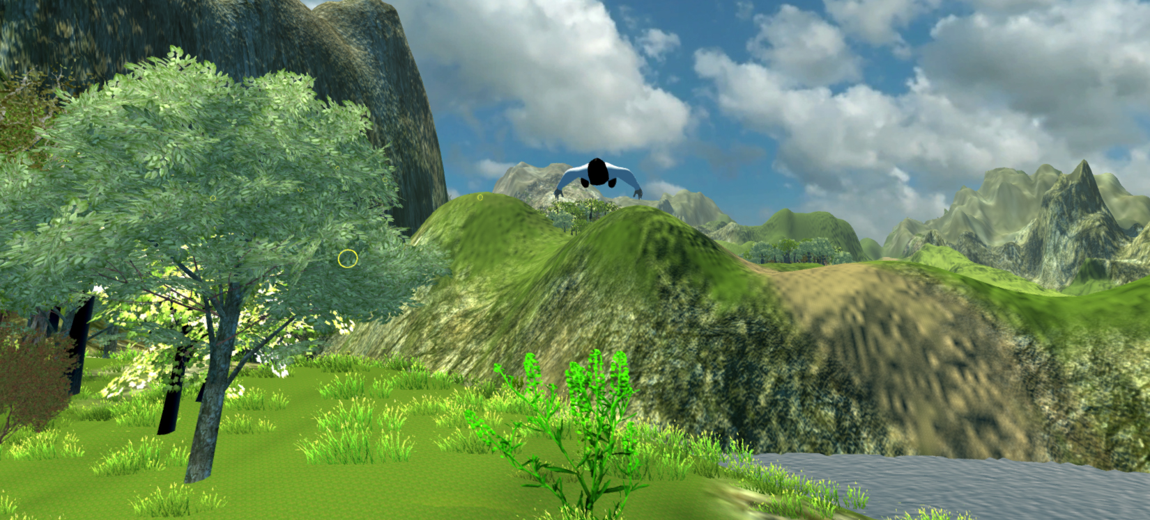
Rift Wingsuit
Sebastian Nickel, Jonas Kleinkauf, Andreas Dietze, Manuel Schmitt, Sascha Ibach

Slide 2
Content
Summary
Project presentation (pp)
Project extension
Responsibilities
Milestones
Risks

Slide 3
Summary
Rift Wingsuit offers a realistic world from the perspective of wingsuit sport. Experience the feeling of total freedom, using the Oculus Rift head-mounted display in combination with guesture control for the protagonist.
Wingsuit valley awaits you !

Slide 4
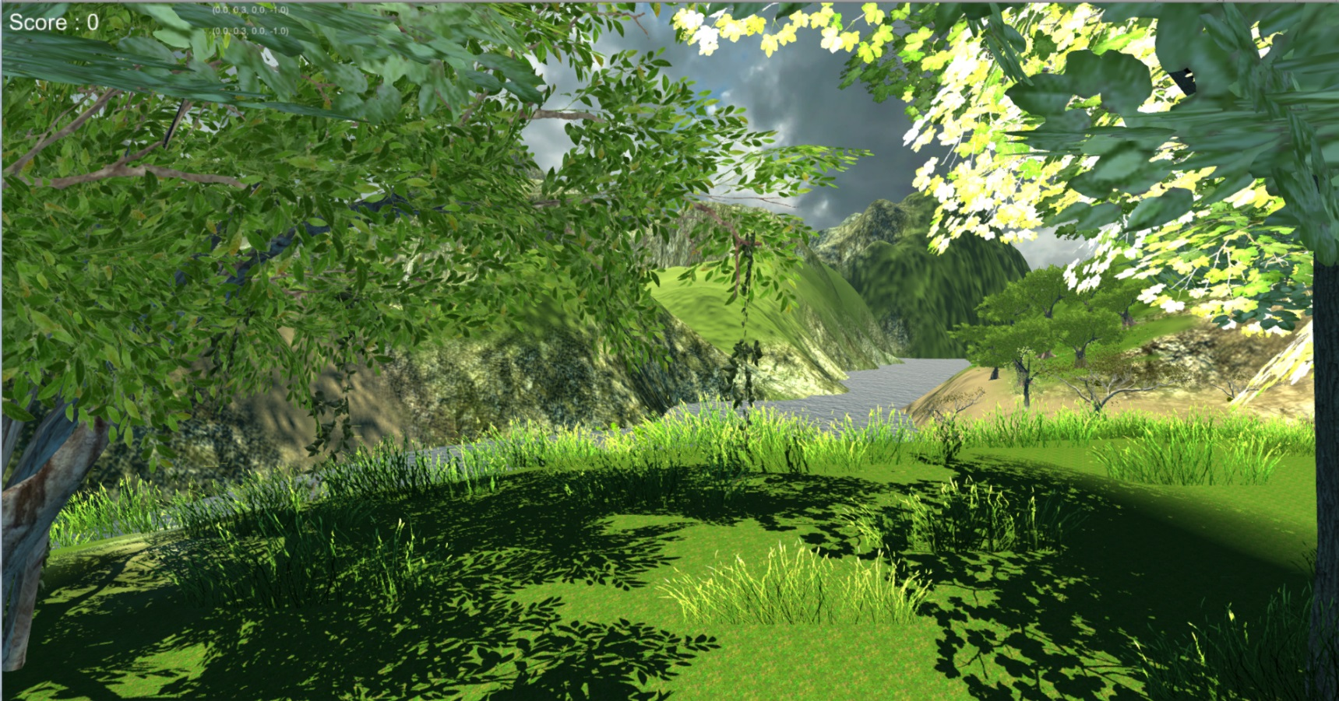
pp - World
Developed with Unity 3D
Deployed assets
Own part
Scripts
Vegetation
Water
Ambiance

Slide 5
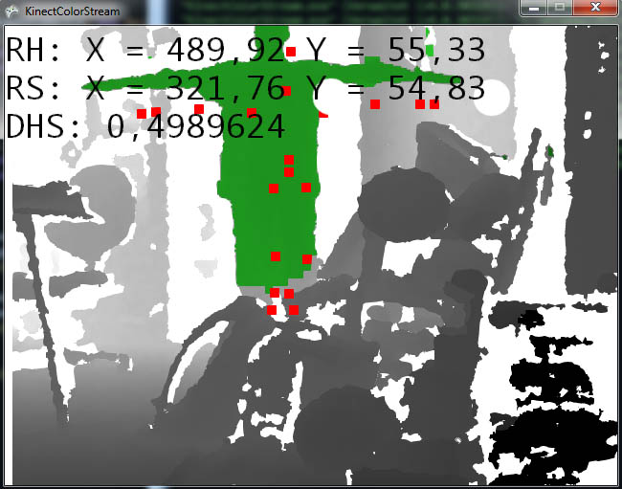
pp – Kinect control
Player control by arm tracking(Kinect):
X-Axis (Pitch)
Forward / Back
Y-Axis(Yaw)
Up / Down
Right-Arm-Tracking
Notes:
Rotation-Lock-X => Es kann nicht übersteuert werden

Slide 6
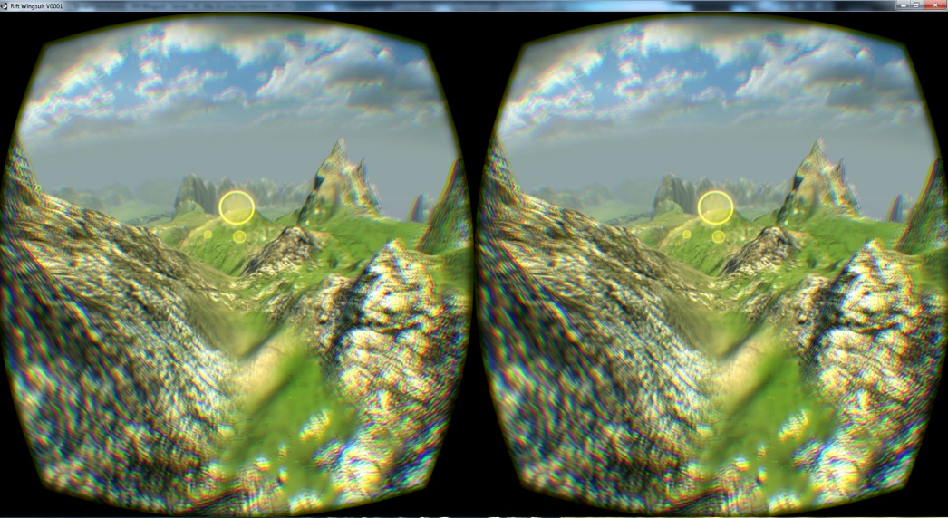
pp - Oculus Rift support
Using head rotation for first-person-view
To make the game more immversive

Slide 7
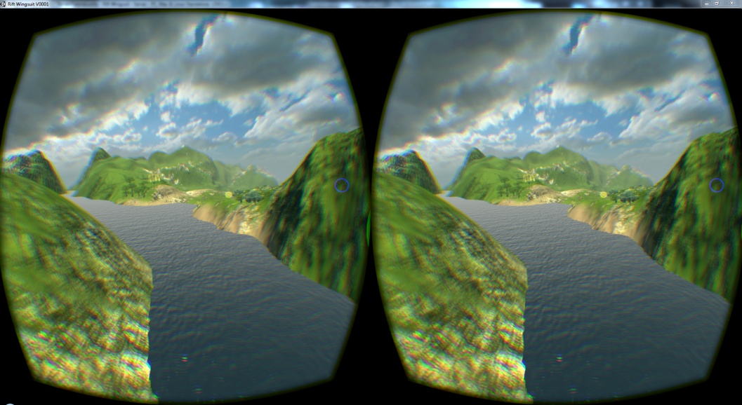
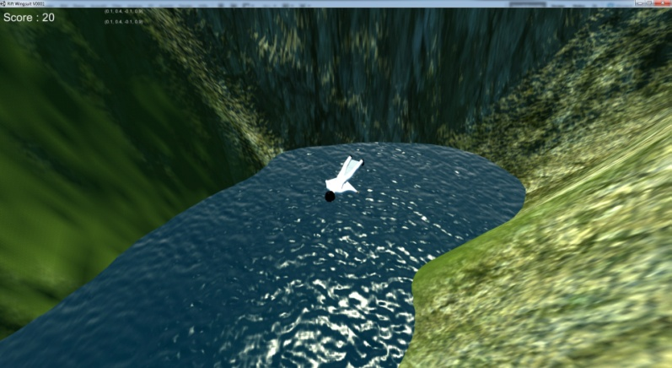
pp - Server and client
Only used as a spectator client
Used for demonstrational purposes
Used to get a better view of the player´s perspective (FPV-Transmission)

Slide 8
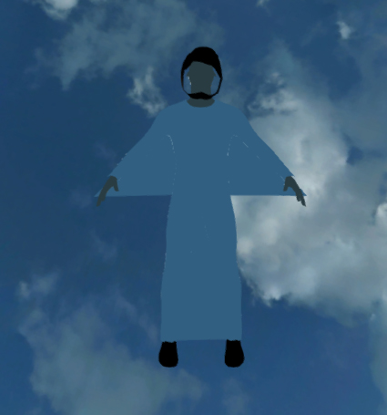
Project extensions
Fly physics
Player model (visible arm movement)
Effect-Events (flying through a bridge)
Rework and/or improve kinect control
Graphical update
Post-effects (radial blur)
Some terrain and world improvements
Clouds
Better lighting

Slide 9
Project extensions
Client improvment
Additional camera styles
Some fly-by-camera styles
Improve existing camera styles
Menues and simplified handling
Game flow (menues and gesture control – maybe makey makey)
Improved construction concept
Location of kinect, player, spectators, etc.
Simplified handling of the game and it´s features
Documentation
Frameworks, Packages
User Guide (how to get it running)
Goal: suitable for HS-LAN and Open-Lab (HS-Informationstage)

Slide 10
Responsibilities (Assistent)
Oculus DK2 / Vive
Sascha Ibach (A. Dietze)
Kinect V1/V2
Andreas Dietze (wer?)
Flyphysics
Andreas Dietze (S. Nickel)
Player model
Jonas Kleinkauf (wer?)
World and ambiance
Jonas Kleinkauf (M. Schmitt)
Post processing
Sebastian Nickel (J.K. ; M.S.)
Audio
Jonas Kleinkauf (A. Dietze)
Menues
Manuel Schmitt (wer?)
Gamelogics
Jonas Kleinkauf (Comp. Grp.)
Documentation and User Guide
Andreas Dietze (M. Schmitt)
Simplified handling
Sascha Ibach (wer?)

Slide 11
Milestone 1
Week | Andreas Dietze
05.12 – 05.19 | Project clean up and initial git uplaod Compatibility test with Kinect V2 (min win 8 :/ ) Setup to old working state with client
05.19 – 05.26 | Setup project (interaction laboratory) for 09.06 Location and setup improvement Check out new world assets
05.26 – 06.02 | Setup project (interaction laboratory) for 09.06 Vive integration, Vive project functionality (visual)

Slide 12
Milestone 2
Week | Andreas Dietze
06.02 – 06.09 | Vive project functionality (haptic and gesture tests) Kinect improvement Balancing the new developed features
06.09 – 06.16 | Vive location and setup improvement Fly physics Documentation
06.16 – 06.23 | Fly physics Documentation User Guide

Slide 13
Exams
16.07.2016 - 30.07.2016 and 12.09.2016 - 24.09.2016
Exam and preperation 23.06 - 30.07
Sec. exam phase -> individual schedule

Slide 14
Milestone 3
Week | Andreas Dietze
08.01 – 08.08 | Fly physics User Guide
08.08 – 08.16 (less time) | Client cam views Client audio Client handling improvement
08.16 – 24.08 | Client improvement buffer
08.24 – 09.14 | Buffer until project end (Fly physics, game locigs, assistant)

Slide 15
Risks
Fly physics
Arm network transmission
Post-effects (scattering, ambient occlusion)
Menues (Oculus)
Guesture control
Suitable for HS-Lan and Open-Lab

Slide 16
Github Version Control
Old project source
https://github.com/andreasdietze/Rift-Wingsuit.git
New project source
https://github.com/andreasdietze/Rift-WingsuitV2.git

Slide 17
Thanks for your attention ☺

